Slide 1
Software Testing Project - CIDR Calculator
Chun-Chi Huang
06/14/2018

Slide 2
Agenda
System Description
Test Unit Description
Function Unit Testing
Structural Unit Testing
Integration Testing
Exploratory System Testing
Scenario Testing
Monkey Testing
Conclusion

Slide 3
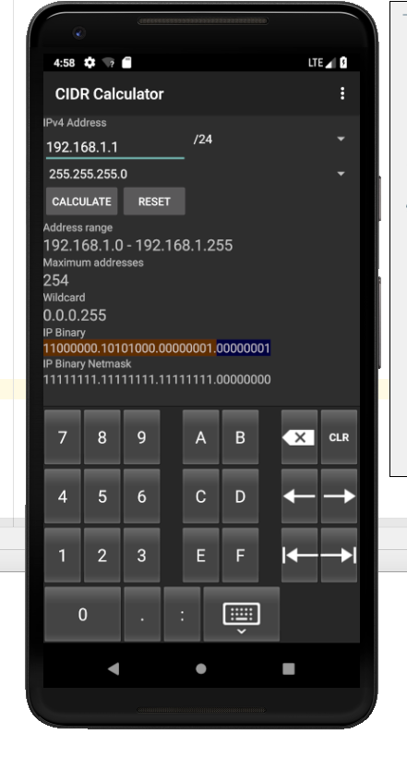
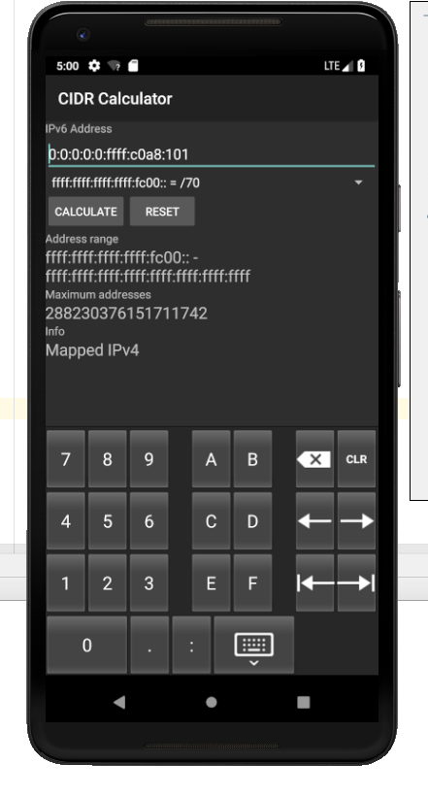
System Description
Classless Inter-Domain Routing Calculator (CIDR Calculator)
IPv4 subnet calculator
a) Address range
b) Maximum address
c) Wildcard
d) IP address in binary/Hex formats
e) IP Netmask in binary format
IPv6 subnet calculator
a) Address range
b) Maximum addresses
c) Extra information
Notes:
Inputs? IP
Outputs? Listed above
Non-functional characteristics? Execution performance and reliability
The highest risks? Pass the monkey testing

Slide 4
Test Unit Description
“Converter” Unit
- Converts the IP address from decimal to binary and hex formats
“InetAddress” Unit
- Evaluates whether the given address is an “IPv4 mapped” IPv6 address
“CIDRCalculator” Unit
Controls the main calculator activity
Focus on public functions and not include Android behavioral functions and private functions.
Notes:
Faults: might be the bit calculation or the determination of valid and invalid IP addresses

Slide 5
Function Unit Testing
Android Studio
JUnit4
Use invalid input and boundary testing techniques

Slide 6
Function Unit Testing – Test Cases (stringIPtoInt)
Num | Description | Input | Expected Output | Status (Passed/Failed/Not executed)
1 | This function should be able to convert an IPv4 address to the integer format. | (String)"192.168.1.1" | (int)-1062731519 | Passed
2 | This function should throw an exception when users input "192.168.1", because it is not a complete IPv4 address. | (String)"192.168.1" | Exception | Passed
3 | This function should throw an exception when users input "192.168..1", because it is not a complete IPv4 address. | (String)"192.168..1" | Exception | Passed
4 | This function should throw an exception when users input "192.168.1.256", because any value in an IPv4 address should be greater than 255. | (String)"192.168.1.256" | Exception | Passed
5 | This function should throw an exception when users input "192.168.1.-1", because any value in an IPv4 address should be positive or zero. | (String)"192.168.1.-1" | Exception | Failed
6 | This function should throw an exception when users input "192.168.1.,", because any value in an IPv4 address should be a digit not a special charater. | (String)"192.168.1.," | Exception | Passed
7 | This function should deal well with the boundary inputs (minimum and maximumvalues) | (String)"0.0.0.0" and (String)"255.255.255.255" | (int)0 and (int)-1 | Passed

Slide 7
Function Unit Testing – Test Results (26/29)
Num | Description | Status (Passed/Failed/Not executed)
1 | This function should be able to convert an IPv4 address to the integer format. | Passed
2 | This function should throw an exception when users input "192.168.1", because it is not a complete IPv4 address. | Passed
3 | This function should throw an exception when users input "192.168..1", because it is not a complete IPv4 address. | Passed
4 | This function should throw an exception when users input "192.168.1.256", because any value in an IPv4 address should be greater than 255. | Passed
5 | This function should throw an exception when users input "192.168.1.-1", because any value in an IPv4 address should be positive or zero. | Failed
6 | This function should throw an exception when users input "192.168.1.,", because any value in an IPv4 address should be a digit not a special charater. | Passed
7 | This function should deal well with the boundary inputs (minimum and maximumvalues) | Passed
8 | This function should be able to convert a digital value to a binary string. | Passed
9 | This function should be able to convert a digital value to a binary string for a minimum or maximum input value. | Passed
Num | Description | Status (Passed/Failed/Not executed)
10 | This function should be able to convert a digital value to a binary string for a minimum or maximum output value. | Passed
11 | This function should throw an exception when users enter a non-digital input | Failed
12 | This function should be able to convert a digital value to a hex string. | Passed
13 | This function should be able to convert a digital value to a hex string for a minimum or maximum input value. | Passed
14 | This function should be able to convert a digital value to a hex string for a minimum or maximum output value. | Passed
15 | This function should throw an exception when users enter a non-digital input | Failed
16 | This function should be able to check whether the user's input is the IPv6 address which can map to an IPv4 address. (True case) | Passed
17 | This function should be able to check whether the user's input is the IPv6 address which can map to an IPv4 address. (False case) | Passed
18 | This function should be able to check whether the user's input is the IPv6 address which can map to an IPv4 address. (False case) | Passed
19 | This function should throw an exception when users enter a non-digital input | Passed
20 | This function should be able to convert an IPv4 address to bytes. | Passed
Num | Description | Status (Passed/Failed/Not executed)
21 | This function should be able to convert an IPv6 address to bytes. | Passed
22 | This function should return null when users enter an invalid IPv4 string. | Passed
23 | This function should return null when users enter an invalid IPv6 string. | Passed
24 | This function should be able to return a IPv4 address string when users enter a valid IPv4 address in InetAddress variable. | Passed
25 | This function should be able to return a IPv6 address string when users enter a valid IPv6 address in the InetAddress format. | Passed
26 | This function should be able to return null when users enter null in the InetAddress format. | Passed
27 | This function should be able to convert a byte array of IPv4 address to an integer. | Passed
28 | This function should be able to convert a byte array of IPv4 address with the low boundaries to an integer. | Passed
29 | This function should be able to convert a byte array of IPv4 address with the up boundariesto an integer. | Passed

Slide 8
Function Unit Testing – Test Coverage
Coverage Summary for Package: us.lindanrandy.cidrcalculator
Package | Class, % | Method, % | Line, %
us.lindanrandy.cidrcalculator | 7.1% (3/ 42) | 10.5% (15/ 143) | 12.5% (138/ 1106)
Class | Class, % | Method, % | Line, %
R | 0% (0/ 8) | 0% (0/ 8) | 0% (0/ 8)
Preferences | 0% (0/ 2) | 0% (0/ 5) | 0% (0/ 18)
NotifySubnet | 0% (0/ 1) | 0% (0/ 2) | 0% (0/ 22)
InetAddresses | 100% (1/ 1) | 83.3% (10/ 12) | 73.1% (95/ 130)
IPv6Calculator | 0% (0/ 5) | 0% (0/ 18) | 0% (0/ 160)
HistoryProvider | 0% (0/ 2) | 0% (0/ 13) | 0% (0/ 132)
HistoryList | 0% (0/ 3) | 0% (0/ 14) | 0% (0/ 69)
CustomKeyboard | 0% (0/ 5) | 0% (0/ 16) | 0% (0/ 70)
Converter | 25% (1/ 4) | 18.8% (3/ 16) | 15% (25/ 167)
CIDRHistory | 0% (0/ 2) | 0% (0/ 3) | 0% (0/ 3)
CIDRCalculator | 12.5% (1/ 8) | 5.9% (2/ 34) | 5.5% (18/ 325)
BuildConfig | 0% (0/ 1) | 0% (0/ 2) | 0% (0/ 2)

Slide 9
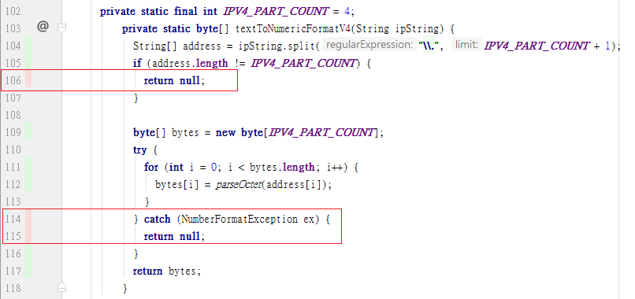
Function Unit Testing – Why Can Not 100% TC
For the missing statements of my unit testing suite, those items are all relevant to the invalid inputs such as “return null” and “exception”.

Slide 10
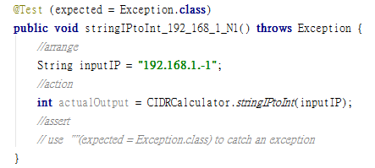
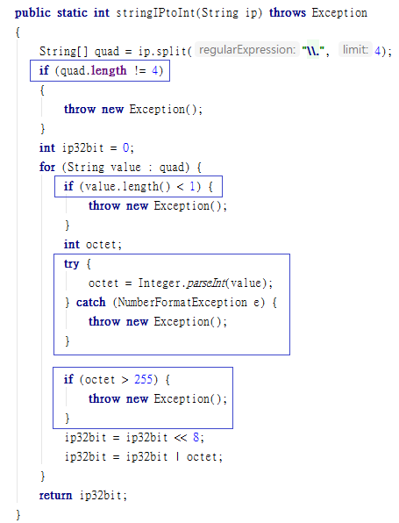
Function Unit Testing – Why Failed?

Slide 11
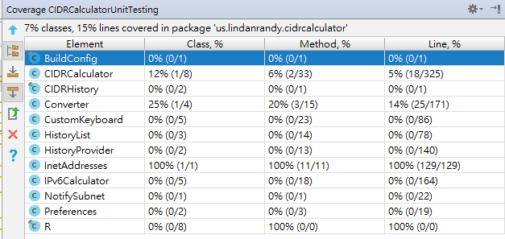
Structural Unit Testing
After adding 15 test cases for those invalid input conditions, the statement coverage becomes 100% (129/129)

Slide 12
Integration Testing - What Each Unit Interacts with?

Slide 13
Integration Testing – Test Cases
The first combined modules are “CIDRCalculator” and “Converter”.
“CIDRCalculator” : deal with the IPv4 address and to render the calculation results
“Converter” : include two functions which convert the IP address into binary or hex format strings.
Test Cases: correct inputs, invalid inputs, or boundary inputs.
The second combined modules are “IPv6Calculator” and “InetAddress”.
“IPv6Calculator” : is similar to “CIDRCalculator”, but it aims at the IPv6 address.
“InetAddress” : provides several functions for “IPv6Calculator” to deal with the IPv6 address.
Test Cases: correct inputs, invalid inputs, or boundary inputs.

Slide 14
Exploratory System Testing
Target device: An Android phone, Sony Xperia Z5 Premium, which contains 5.5” panel with Android 7.1.1 version.
Includes:
Landmark tour: Select key features to test.
FedEx tour: Aim at the data flowing through this app.
Back Alley tour: Focus on the rarely used feature.
Lonely Businessman tour: Find the features which are furthest away from the starting point of this app.
Garbage Collection tour: Check the display of every column.
Supermodel tour: Check whether UI display of this app is appropriate.
Couch Potato tour: Do as little as work as possible.
Antisocial tour: Enter the bad inputs to test.
After-Hours tour: Check whether the data can be kept.

Slide 15
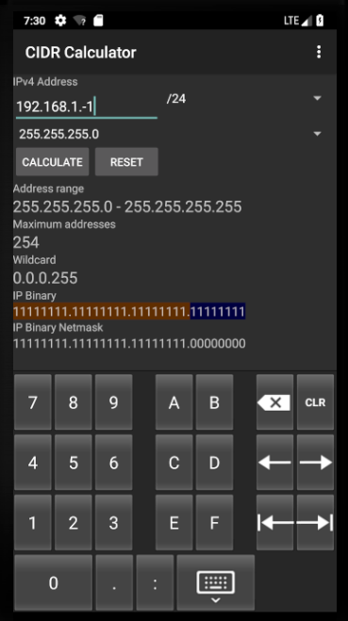
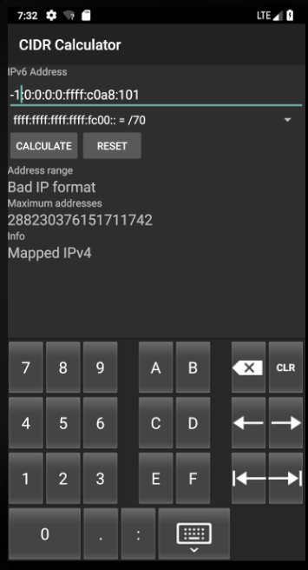
Exploratory System Testing – Test Result
There were two bugs found.
If users enter an IPv4 address with a negative value, this app would show the message “Bad IP format”.
if users enter a valid IPv6 address and do calculations and then enter an invalid address, not all of the results are updated.

Slide 16
Scenario Testing – Tool and Test Cases
Using Robotium
Test Cases:
1. IPv4 Calculation
Enter a valid IPv4 address, and then do calculation, followed by checking the results.
Enter an invalid IPv4 address, and then do calculation, followed by checking the results.
Enter a valid IPv4 address, and then do calculation with selecting a different IPv4 mask, followed by checking the results.

Slide 17
Scenario Testing – Test Cases and Test Result
2. Converter
Enter a valid IPv4 address, and the do calculation.
Send MENU key, and then select “Converter”.
Check whether the IP address of Converter is the same with the previous input address, and then check other results.
3. IPv6 Calculation
Send MENU key, and then select “IPv6”.
Enter a valid IPv6 address, do calculation, and then check the results.
Select a different IPv6 mask, do calculation, and then check the results.
All of these three tests are passed.

Slide 18
Monkey Testing
Events generated:
Touch event: ACTION_DOWN and ACTION_UP.
Trackball event: ACTION_MOVE.
Flip event. However, when this event was sent, and IOException happened, it did not break the monkey testing.
Rotation event: cause the screen rotation.
No bugs were found.
If the mobile phone is not reliable, it is easy to fail in the monkey test.
Monkey testing is a useful tool to verify the stability of mobile applications.

Slide 19
Conclusion
Learned from this project
Android Studio, JUnit, Robotium
Functional testing strategies, code coverage, scenario testing
Biggest challenges
Select a proper target Android app
Do differently if you were to test a similar app
Understand the algorithms and mechanisms first
Apply more functional testing strategies such as equivalence class testing, output testing, and catalog based testing
Try Appium to proceed with the scenario testing instead of Robotium

Slide 20
Q&A

Slide 21
Thank You

